Slide 1





Utilizing real world marketing data
Focus on efficient marketing optimization
Marketing Campaign Optimization Using Uplift Modeling
Presented By:
Harshita Bansal
(IMT2023035)
Pragya Rai
(IMT2023529)
Maximizing uplift within the budget
Addressing key business challenges
https://github.com/Harshita30-bansal/UPLIFT-MODELING-OPTIMIZATION

Slide 2

Dataset Overview — Criteo Uplift Modeling Dataset.
Original size: ~13 million rows
Sampled dataset used: 1 million rows
(stratified sampling)
Features: 12 anonymized numerical
user attributes (f0–f11)
Key variables:
– treatment: whether user received the promotion
– visit / conversion: user response outcome
Dataset characteristics:
– Highly imbalanced (≈85% treated, ≈97% non-converters)
– Large-scale, noisy real-world marketing behavior data

Slide 3

Real-World Problem & Motivation
• Marketing campaigns are expensive; not every customer responds.
• Traditional ML predicts likelihood of buying, not the incremental effect of promotions.
• Sending promotions to all customers wastes budget and reduces ROI.
• Key question: Who should receive the promotion to maximize incremental lift?
• Uplift modeling estimates the causal impact of treatment on each customer. Optimization is required to:
– maximize total uplift,
– avoid wasted promotions,
– work within limited budget/resources.

Slide 4

Notation (common to both problems)
• N : number of customers, indexed i = 1,…,N
• xᵢ ∈ {0,1} : decision variable
(xᵢ = 1 → customer i is selected/targeted)
• Tᵢ ∈ {0,1} : observed treatment assignment
(Tᵢ = 1 → promotion was shown to customer i)
• Yᵢ ∈ {0,1} : observed outcome
(Yᵢ = 1 → customer visited / converted)
• Xᵢ : feature vector for customer i
(input feature attributes f₀,…,f₁₁)
• M₁, M₀ : predictive esimations
P(Y=1 | T=1, X) and P(Y=1 | T=0, X)
• p̂₁(Xᵢ) = M₁(Xᵢ)
p̂₀(Xᵢ) = M₀(Xᵢ)
•Causal objective:
Estimate the individual treatment effect (ITE):
We do not observe both Y(1) and Y(0) for any individual →
the fundamental challenge.
ûᵢ = p̂₁(Xᵢ) − p̂₀(Xᵢ)
(individual uplift estimate)
• Selection rule:
xᵢ = 1 if ûᵢ > 0, else 0

Slide 5



Easy Problem — Unconstrained Uplift Maximization
Modeling Approach:
Interpretation:
Select every customer who benefits from treatment
Equivalent to sorting users by uplift and picking all positive ones
Fast, scalable, and works as an approximate uplift optimizer
Treated Model (RF₁): • Train a Random Forest on users who received the promotion (T = 1) • Predicts:
$${\hat{p}}_{1}\left(X_{i}\right)=P\left(Y , =1∣T=1X_{i}\right)$$
Control Model (RF₀): • Train a Random Forest on users who did NOT receive the promotion (T = 0) • Predicts:
$${\hat{p}}_{0}\left(X_{i}\right)=P\left(Y , =1∣T=0X_{i}\right)$$
Individual Uplift Estimate:
$${\hat{u}}_{i}={\hat{p}}_{1}\left(X_{i}\right)−{\hat{p}}_{0}\left(X_{i}\right)$$
.
​

Slide 6





Hard Problem — Neural Network–Based Uplift Optimization
Motivation:
The easy problem uses two independent Random Forest models, which:
Cannot capture complex interactions between features and treatment
Have higher variance when treatment groups are imbalanced
To improve accuracy, the hard problem uses a single neural network with shared representation learning.
Neural Uplift Estimation:
Outcome heads:
Propensity head:
Factual prediction:
Objective Optimisation problem

Slide 7



Hard Problem — Neural Network–Based Uplift Optimization
Outcome regression loss
Targeted Regularization loss
Target Loss

Slide 8


Why This is a “Hard” Optimization Problem
Training the NN is a non-convex optimization problem
Loss surface contains many local minima
Requires treatment masking, balanced sampling, regularization
Jointly learning ${\hat{p}}_{1}$and ${\hat{p}}_{0}$introduces multi-output coupling
Much more computationally expensive than the easy problem
Higher risk of overfitting due to the uplift signal being weak

Slide 9

Implementation summary
Key steps implemented:
1. Stratified sampling (13M → 1M) and stratified train/val/test split
2. Preprocessing pipeline (low-variance filter, clipping, log-transform, Standard Scaler)
3. Two-model Random Forest uplift (Easy)
4. Shared Neural Network uplift (Hard) — shared layers + two heads
5. Uplift scoring: ûᵢ = p̂₁(Xᵢ) − p̂₀(Xᵢ)
6. Evaluation: Qini curve, AUUC, Qini coefficient

Slide 10
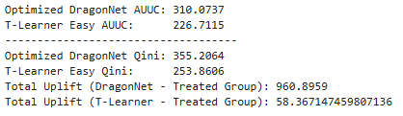
Verification — objective & selection rules
Objective (what we maximize):
J(x) = ∑ᵢ₌₁ⁿ uplift· xᵢ
Selection rules implemented:
• Easy (2-model RF): xᵢ = 1 if uplift > 0
• Hard (shared NN): xᵢ = 1 if uplift > 0
DragonNet achieves
~33% gain in AUUC
~34% gain in Qini
It validates that our complex optimization problem lead to higher-quality causal effect estimation.

Slide 11
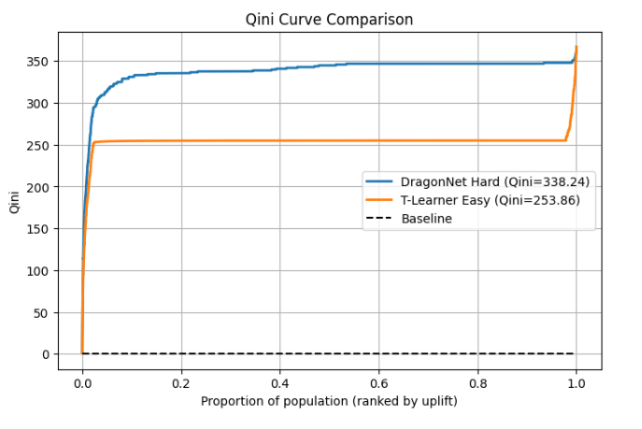
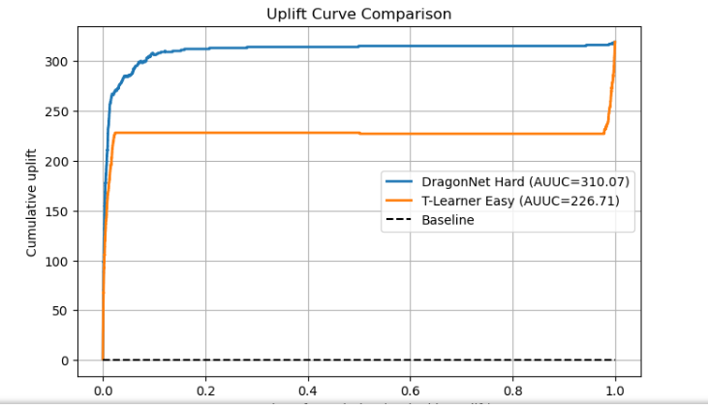
​Metrics Used for Uplift

Slide 12
Easy Vs Hard: Trade off
EASY
HARD
• Two separate Random Forest models (treatment & control)
•baseline but does not capture complex treatment-feature interactions
• high variance
Low computational cost
• One neural network with shared layers + 2 heads
• Captures complex treatment–feature effects
• More computationally expensive for finding iterative best parameters
Hard problem adds realism by learning a richer uplift function
but may sacrifice stability and interpretability.

Slide 13
Price of Realism
1. Higher Computational Cost
Our architecture uses deep neural networks, shared layers, and multi-head outputs.
2. Non-Convex Optimization
Training involves many local minima and saddle points.
No guarantee of reaching the global optimum.
3. Longer Training Time
Backpropagation + batch training + early stopping = slower compared to simple RF fits.
4. Lower Interpretability
Neural networks act as black boxes.
Harder to explain which features drive uplift.
5. Greater Sensitivity to Hyperparameters
Needs tuning for: learning rate, L2 regularization, dropout, hidden units, batch size, TARReg ratio
Poor choices can significantly degrade performance.

Slide 14



How Did the Added Complexity Change the Optimal Solution?
The Hard Model Learns Treatment–Feature Interactions (Easy Model Does Not)
It explicitly models the probability of treatment assignment (propensity score) u
This helps correct for imbalance of treatment indicator making uplift estimation more accurate.
Targeted Regularization (TARReg) Explicitly Shapes Counterfactuals

Slide 15


